Slide 1
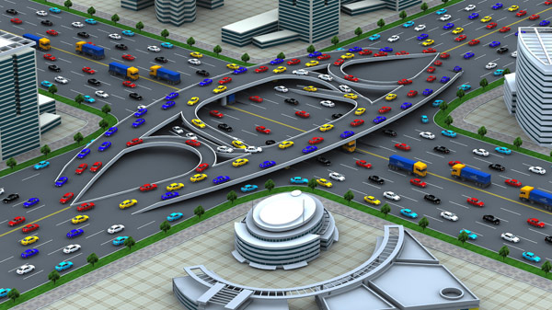
Traffic Engineering
University of Diyala
College of Engineering
Civil Engineering Department

Slide 2
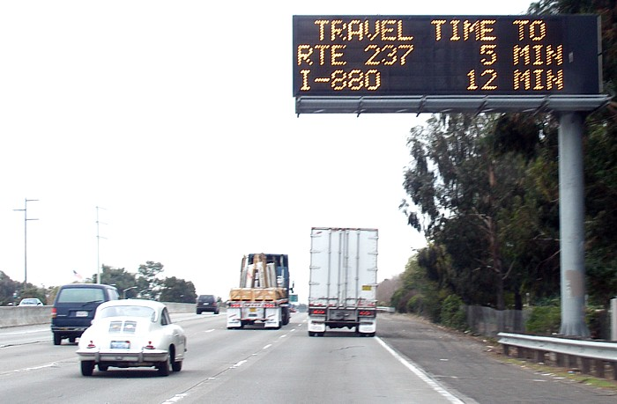
Travel Time Studies

Slide 3
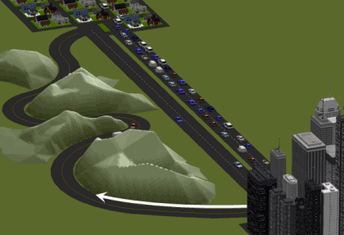
Travel time is the time taken by a vehicle to traverse a given section of a highway.
It is often conducted on the arterial or major roadway, along which there are several intersections (signalized or stop/yield signs).
Travel time plays key role in city’s life and it indicates the level of service of roadway network performance.

Slide 4
Purpose of Travel Time Studies
to identify problem locations on facilities
to determine level of service of the facility
to provide some inputs for traffic assignment process
to provide travel time for economic evaluation of transportation improvement.
to provide information for travelers

Slide 5
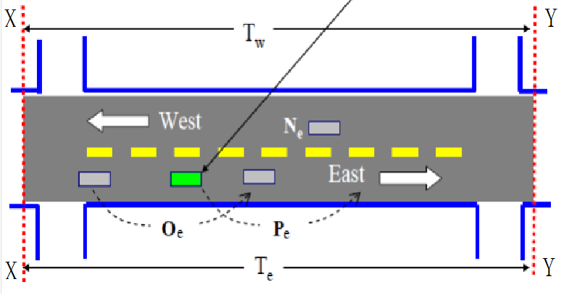
Measurement Methods
1- Moving Observer Method:

Slide 6
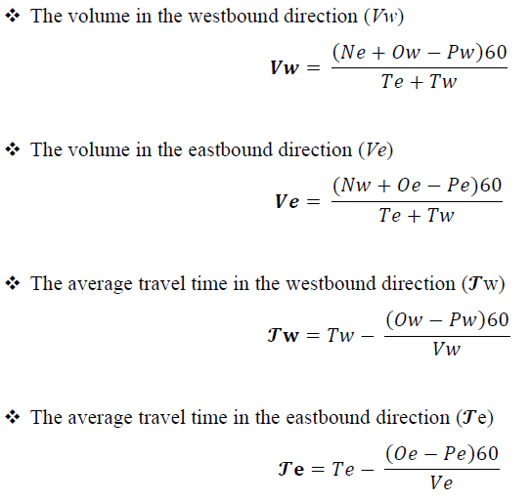

Slide 9
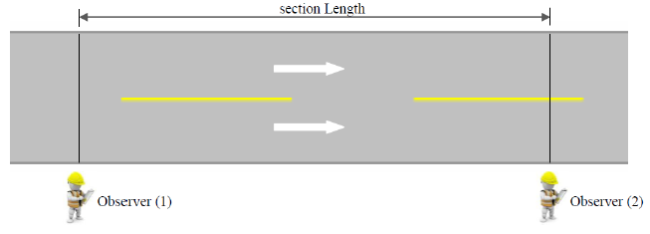
Measurement Methods
2- Registration Number Method:
This method is similar to direct – timing procedure method that discussed earlier.

Slide 10
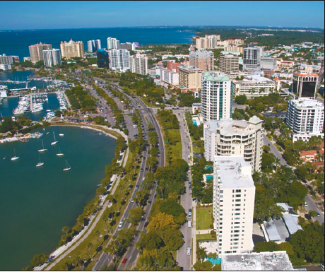
Measurement Methods
3- Elevated Observer Method:
In this method, the observers stationed on top of an elevated building select vehicles at random and follow their course along the road.
Noting the time of entering the test section, duration and nature of delays suffered and time of leaving.
The test section has to be short, such as a street in the central area of city.

Slide 11
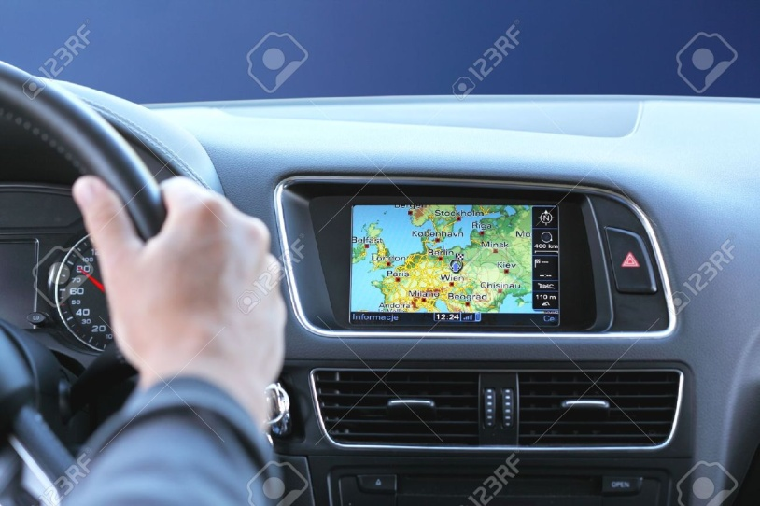
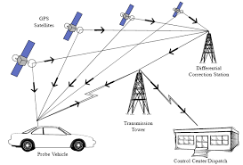
Measurement Methods
4- GPS Based Method:
GPS based approach is the update method to get developed in recent years.
The GPS device is installed at each testing vehicle and movement information of each vehicle on the roadways will be received by the control center.
The travel time will be then calculated based on predetermined algorithm.
This approach is still at the testing stage.

Slide 12
Example-1
Run Direction/ Number | Travel Time (min) | No. of Vehicles Traveling in Opposite Direction | No. of Vehicles that Overtook Test Vehicle | No. of Vehicles Overtaken by Test Vehicle
Eastward
1 | 2.75 | 80 | 1 | 1
2 | 2.55 | 75 | 2 | 1
3 | 2.85 | 83 | 0 | 3
4 | 3.00 | 78 | 0 | 1
5 | 3.05 | 81 | 1 | 1
6 | 2.70 | 79 | 3 | 2
7 | 2.82 | 82 | 1 | 1
8 | 3.08 | 78 | 0 | 2
Average
Run Direction/ Number | Travel Time (min) | No. of Vehicles Traveling in Opposite Direction | No. of Vehicles that Overtook Test Vehicle | No. of Vehicles Overtaken by Test Vehicle
Westward
1 | 2.95 | 78 | 2 | 0
2 | 3.15 | 83 | 1 | 1
3 | 3.20 | 89 | 1 | 1
4 | 2.83 | 86 | 1 | 0
5 | 3.30 | 80 | 2 | 1
6 | 3.00 | 79 | 1 | 2
7 | 3.22 | 82 | 2 | 1
8 | 2.91 | 81 | 0 | 1
Average

Slide 13
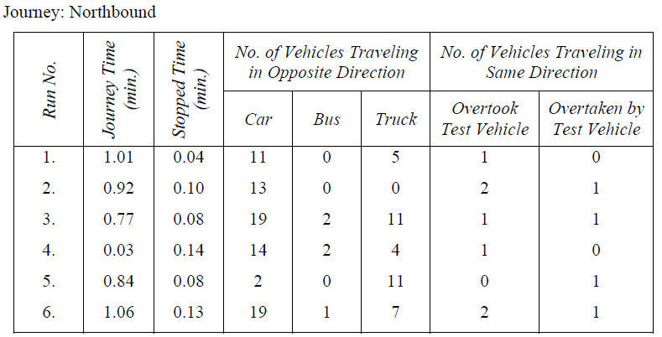
Example-2
The following tables give the particulars collected for a section of road 0.7 km long during the course of a moving observer study

Slide 14
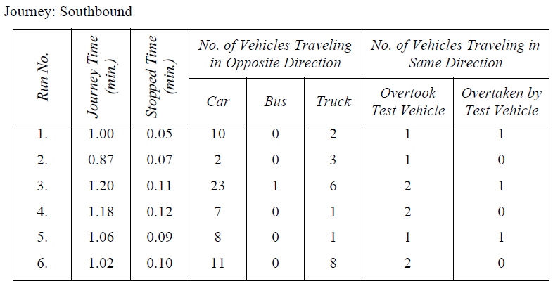
Example-2
Calculate the flow in PCU/hr in both directions of traffic, and calculate the journey speed and running speed?

Slide 15
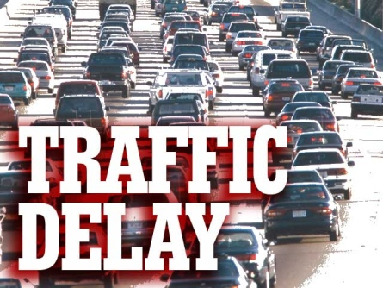

Slide 16
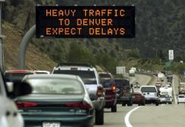
Delay is the time lost by a vehicle due to causes beyond the control of the driver.
Operational delay
Stopped-time delay
Fixed delay (Control delay)
Travel-time delay

Slide 17
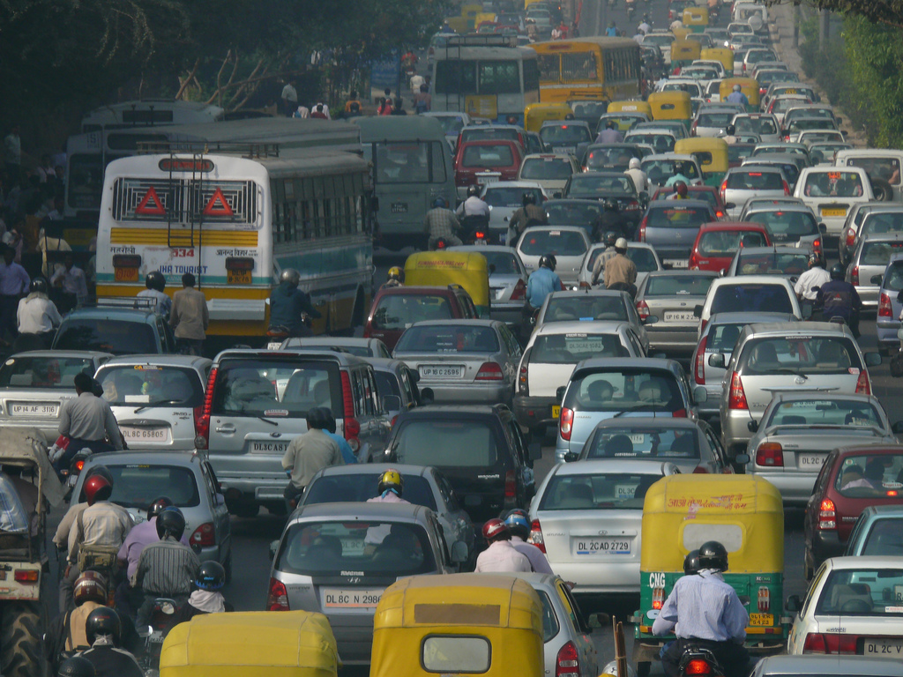
Operational delay (Congestion delay)

Slide 18
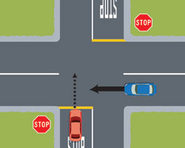
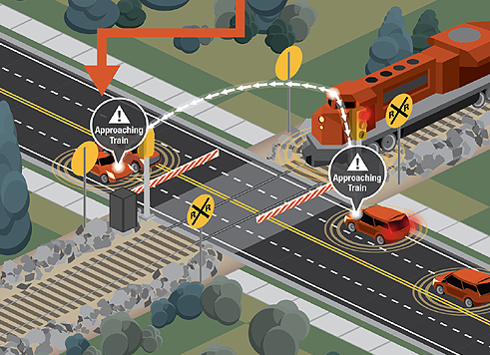
Stopped-time delay

Slide 19
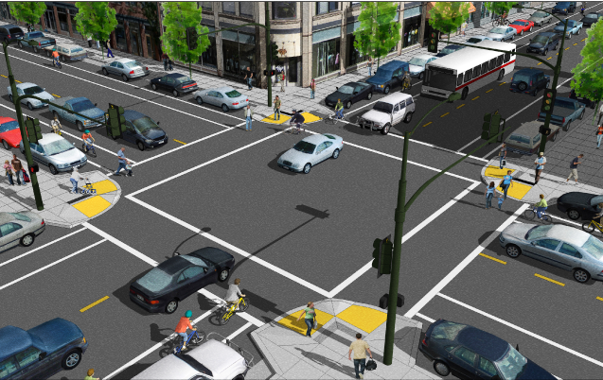
Fixed delay (Control delay)

Slide 20
Measuring of Congestion Delay
In case of main routes:- determine the running speed when the traffic condition are free moving and vehicles are not impeded, and to call this a reasonable running speed, normally the maximum value will be the speed limit is to be taken. This values has to be compared with the running speed.
In case of city center streets:- determine the average spot speeds, measured at points where is no immediate interference to traffic flow i.e. at point as far removed from intersection, pedestrians crossings, etc. and to call this the reasonable speed. This value has to be compared with running speed.

Slide 21
Factors affecting Delaying
1- Physical factors:
Such as the number of lanes, width, grades, channelization, bus stop.
2- Traffic factors:
Such as volume on each approach, turning movement, driver approach speed, parking and pedestrian.
3- Traffic controls:
Such as timing of signals, stop sign.

Slide 22
Example-3
Section of route length of 335m, with average journey time 75sec, average running speed 21 kmph, and average running time 57sec, where the speed limit 50 kmph and average spot speed 26.9 kmph. Determine the congestion delays in the case of:
Main Street.
City Center Street.

Slide 23

Delay Survey Procedure
Identify the farther extent of standing queues.
At regular interval (15 second) record the number of vehicles stopped with the intersection.
During the entire period of study maintain a volume count and total stopped and non-stopped vehicles (arriving vehicles)
Sum each column of stopped vehicle counts then average stopped delay per vehicle can be computed as:-

Slide 24
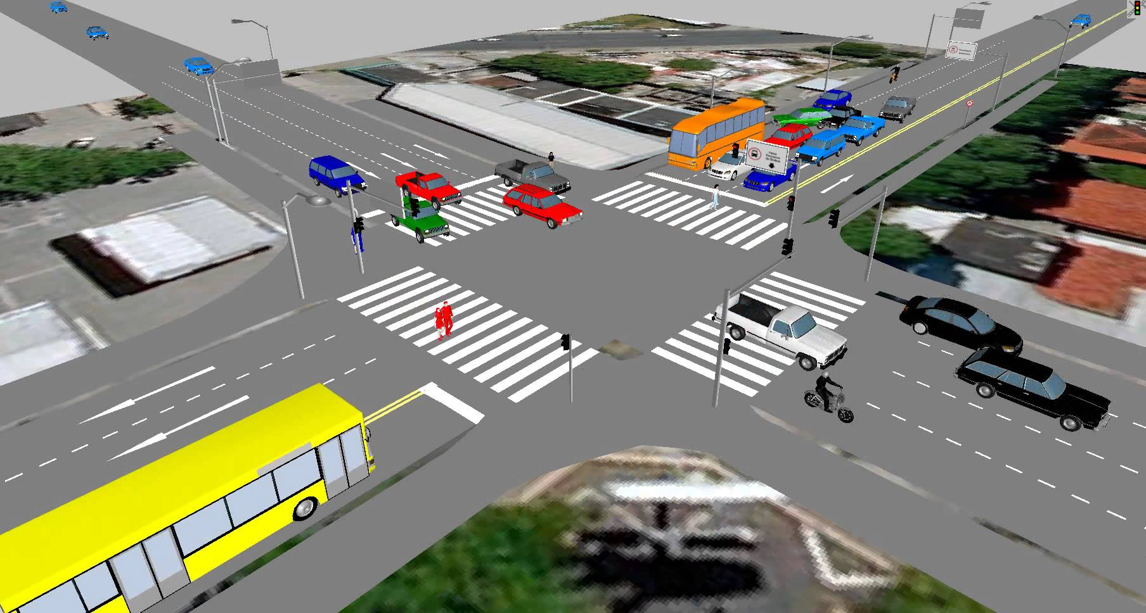

Slide 25
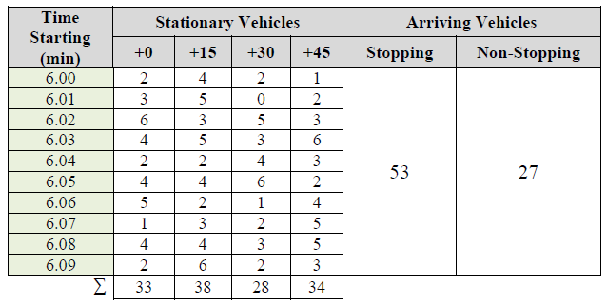
Example-4

Slide 27


